Slide 1
Bioacoustics: A (Very) Brief Overview
Ed Baker
ACOUSTIC BIOLOGY RESEARCHER Natural History Museum, London

Slide 2
notes
Mainly broad rather than now
Some biology, data science, hardware, software, ecology, taxonomy...
… by necessity very interdisciplinary

Slide 3
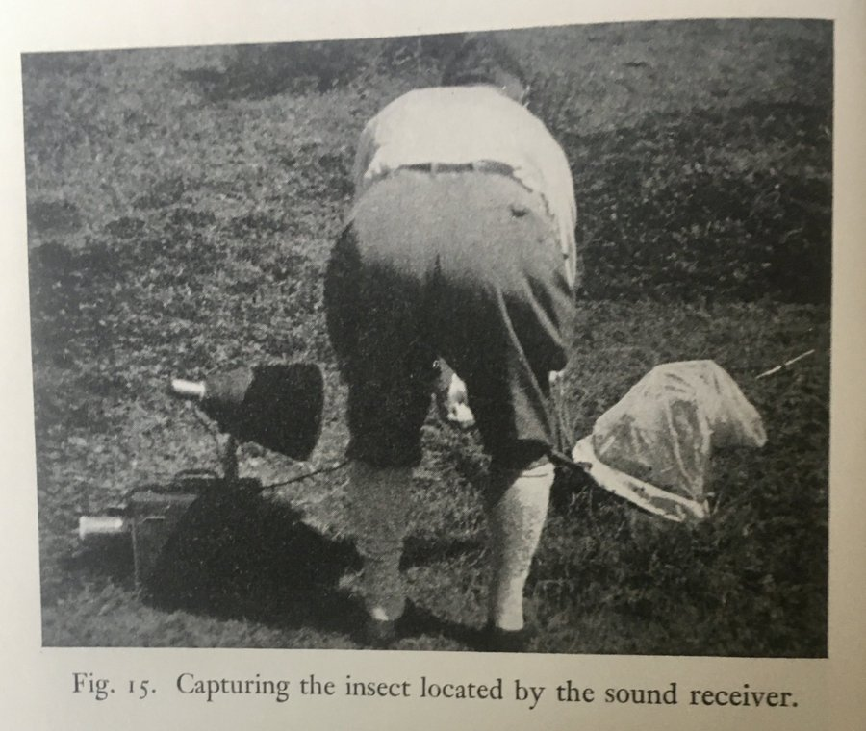
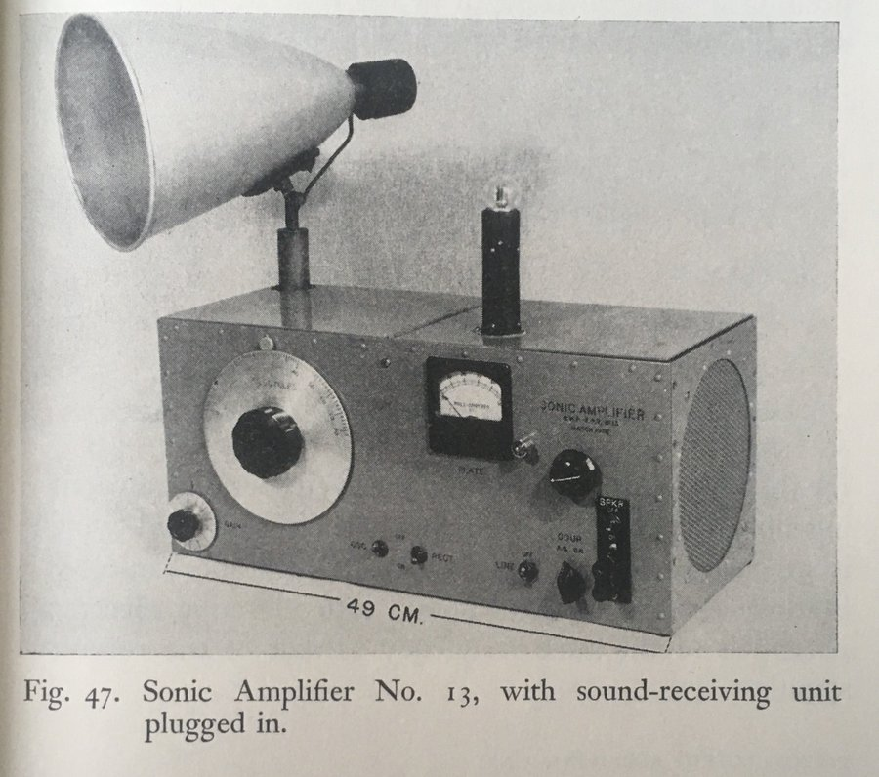
G. W. Pierce (1948)

Slide 4
G. W. Pierce (1948)

Slide 5
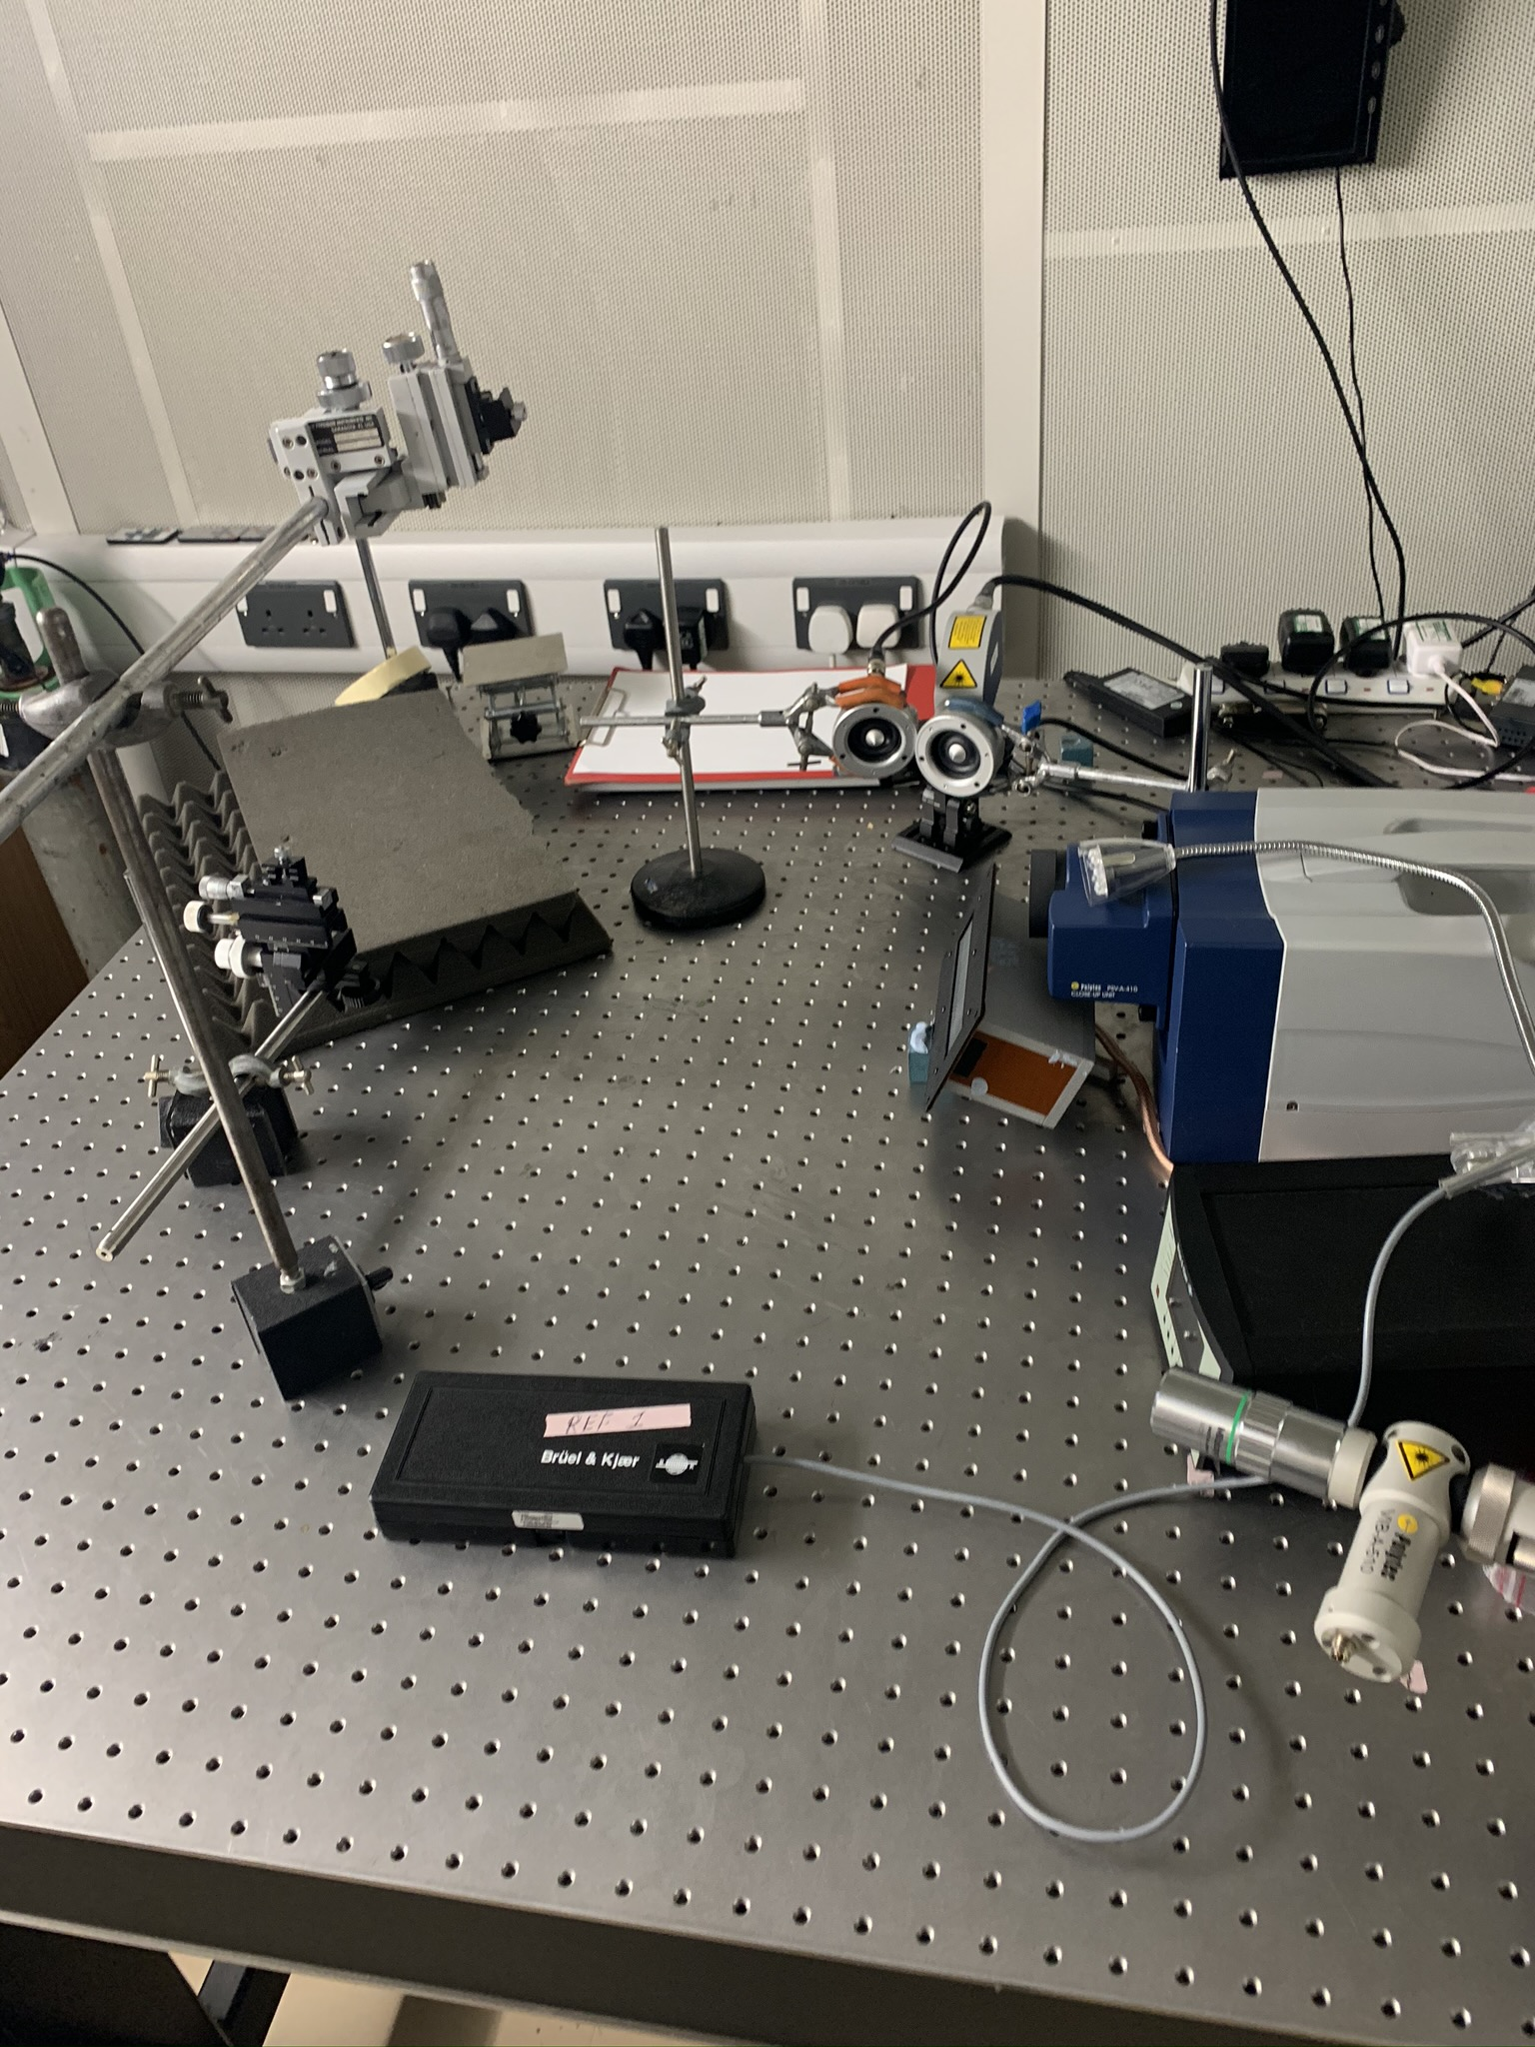

Slide 6
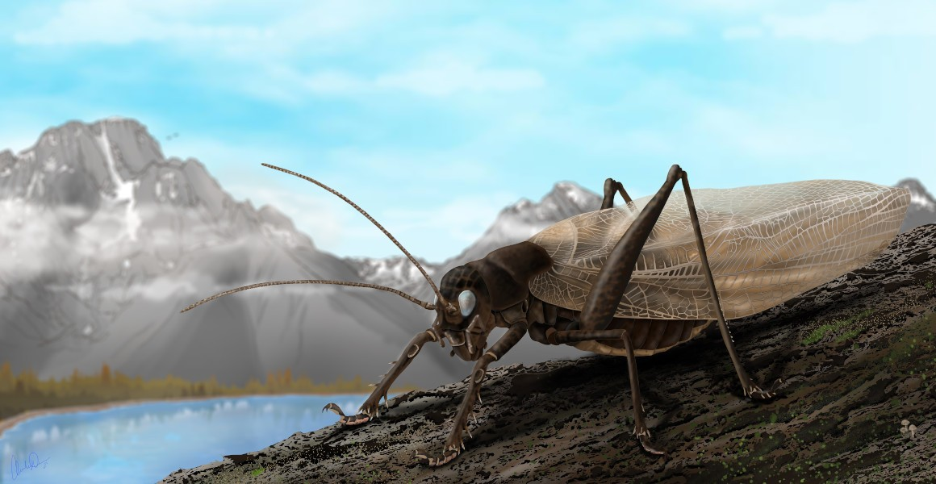

Slide 7
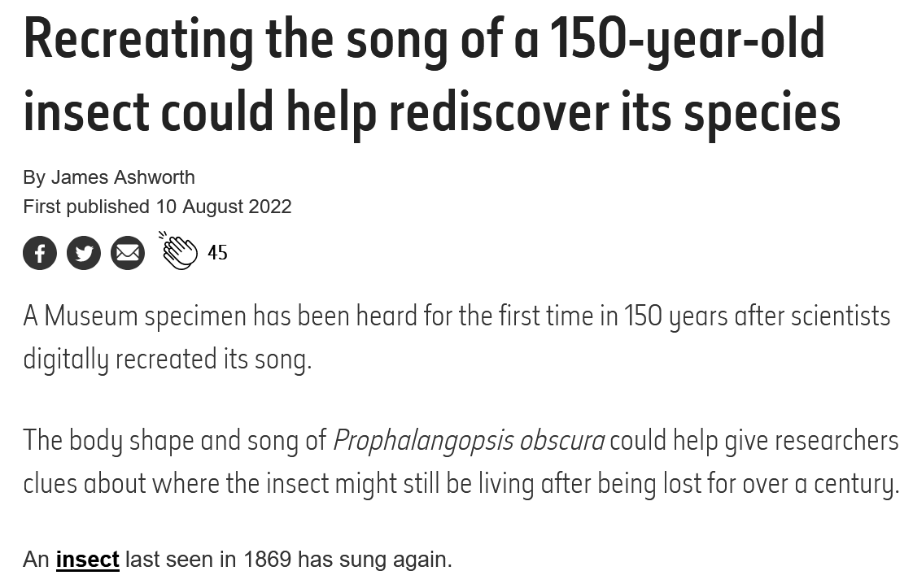

Slide 8
Why do animals make sounds?
To communicate
Navigation
As a form of defence
Incidental noises

Slide 9
Why study sounds?
Relatively cheap way of monitoring biodiversity 24/7
For some groups (e.g. birds) can give clues to behaviour
Non-disruptive
Noise

Slide 10
The Challenges
We don’t know what everything sounds like
Volume of data to analyse and store (£££, time, computers)
Everything but birds and whales

Slide 11
ARTHROPOD bioacoustics
Some Biology

Slide 12
The other 95% of bioacoustics
Dominant biophony in freshwater and tropical terrestrial environments
Significant biophony in some marine environments
Dominant biophony in timber crops and decaying wood
Dominant biophony in soil (probably)

Slide 13
…Just the Insects

Slide 14
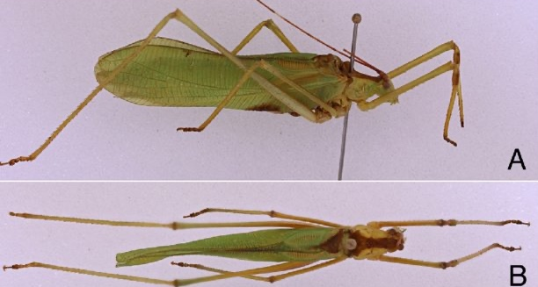
Orthoptera: Bush Crickets

Slide 15
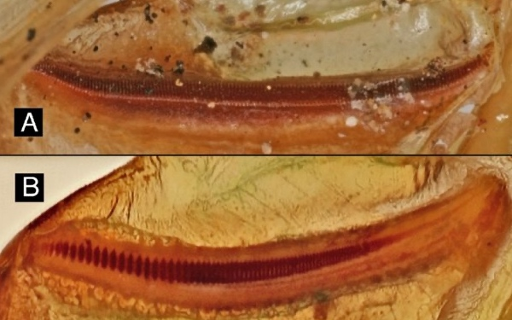
Orthoptera: Bush Crickets

Slide 16
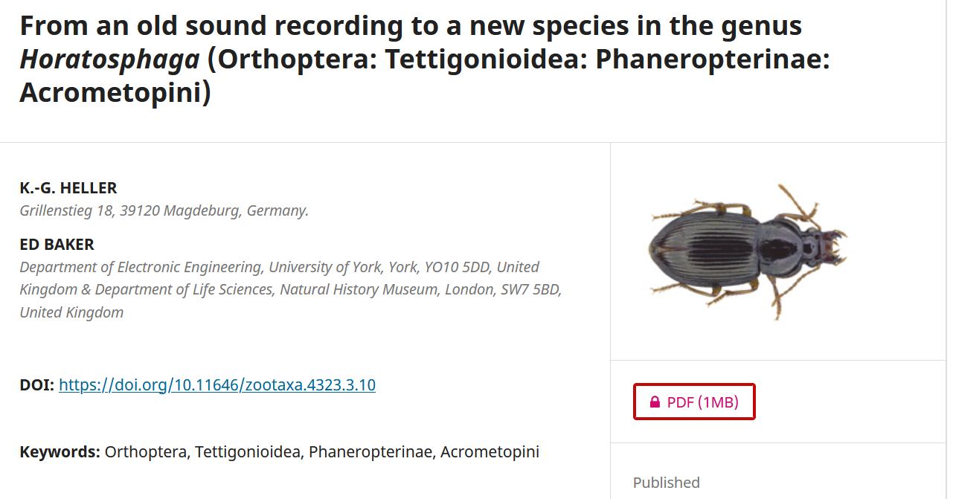

Slide 17
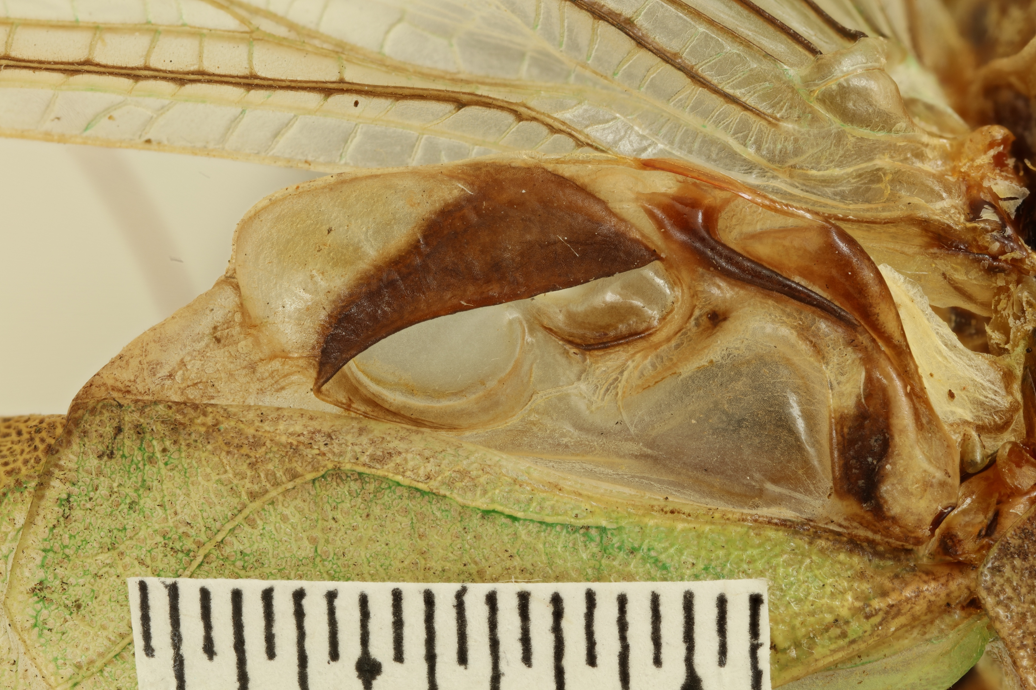
Orthoptera: Bush Crickets

Slide 18
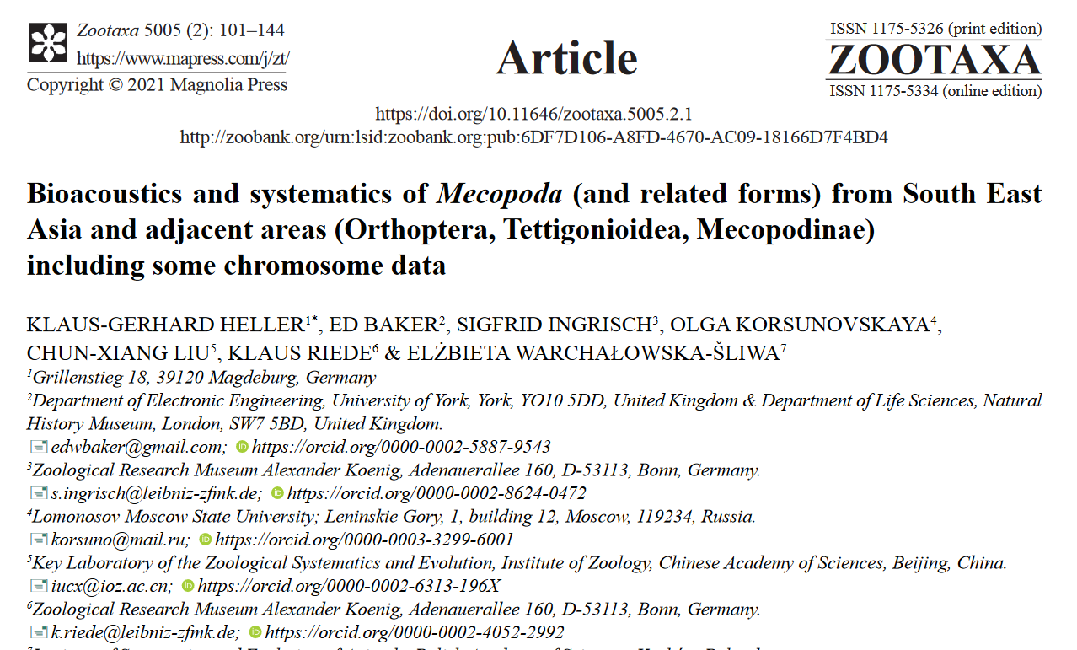

Slide 19
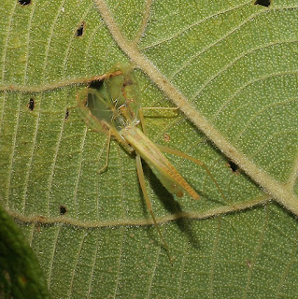

Slide 20
Orthoptera: MOLE Crickets

Slide 21
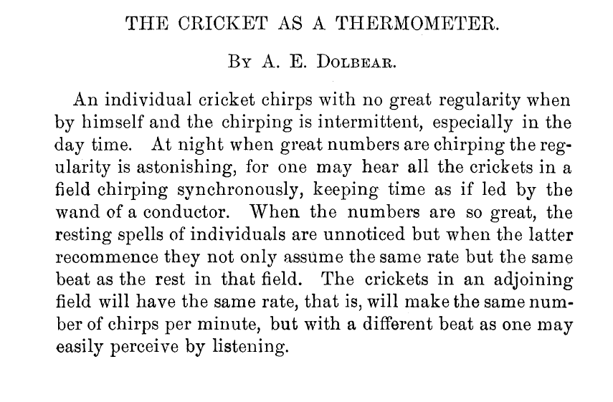

Slide 22
LEPIDOPTERA

Slide 23
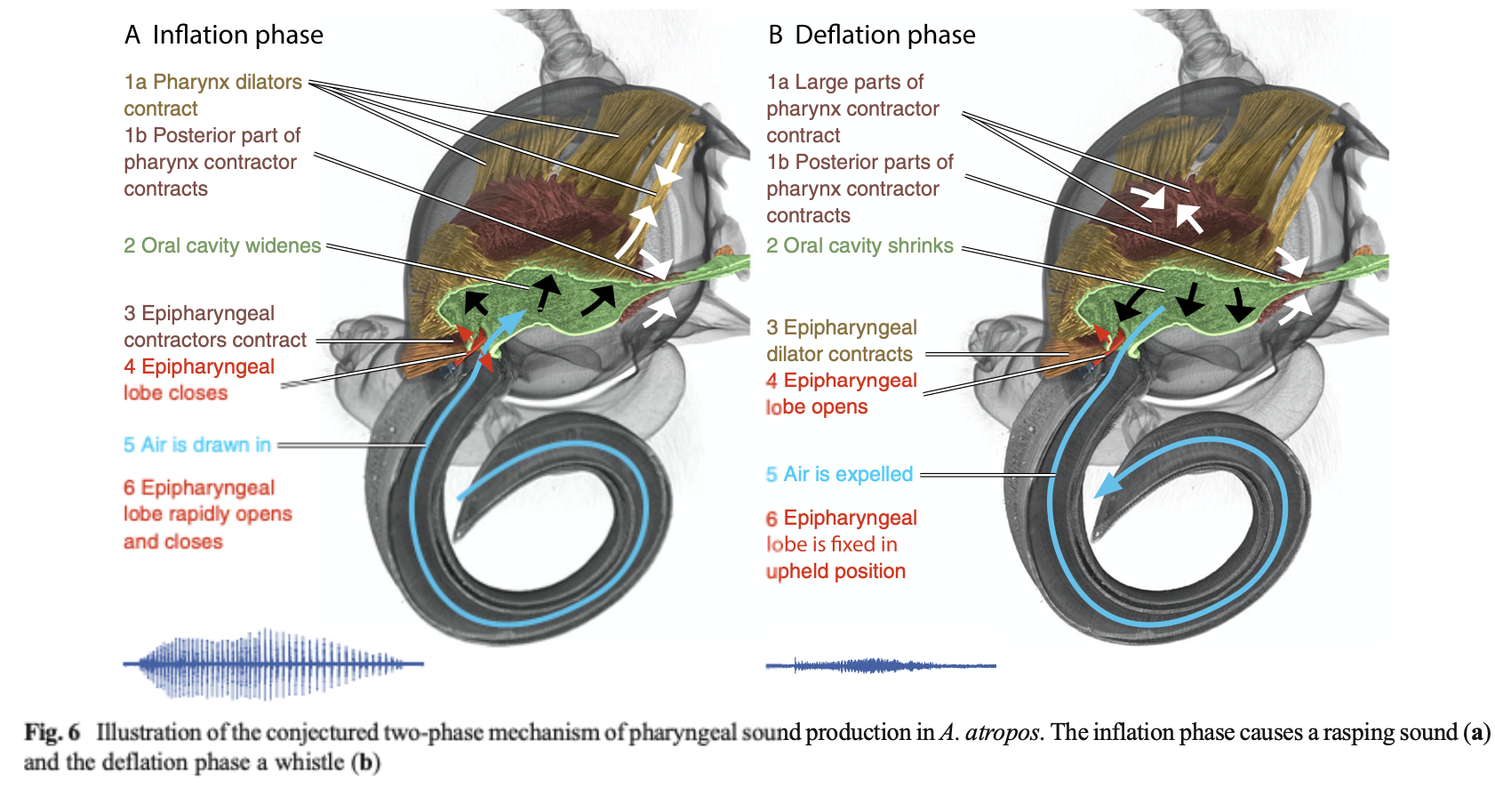
LEPIDOPTERA

Slide 24
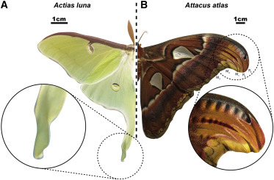
https://doi.org/10.1016/j.cub.2021.08.038

Slide 25
BLATTODEA

Slide 26
HEMIPTERA: CICADAS

Slide 27
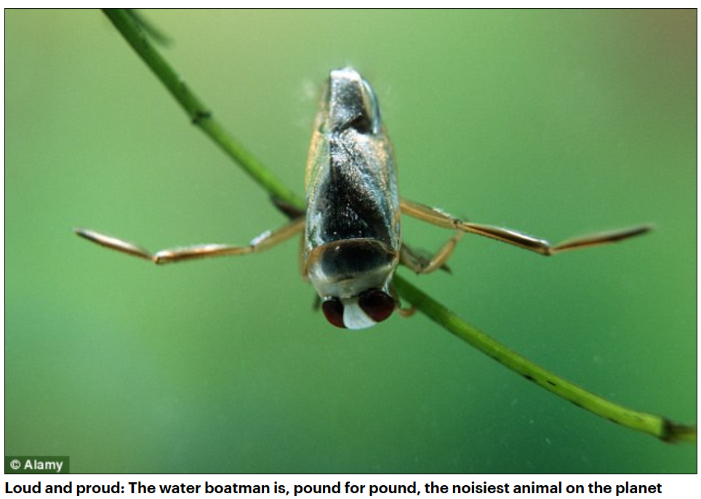

Slide 29
Incidental Noises

Slide 30
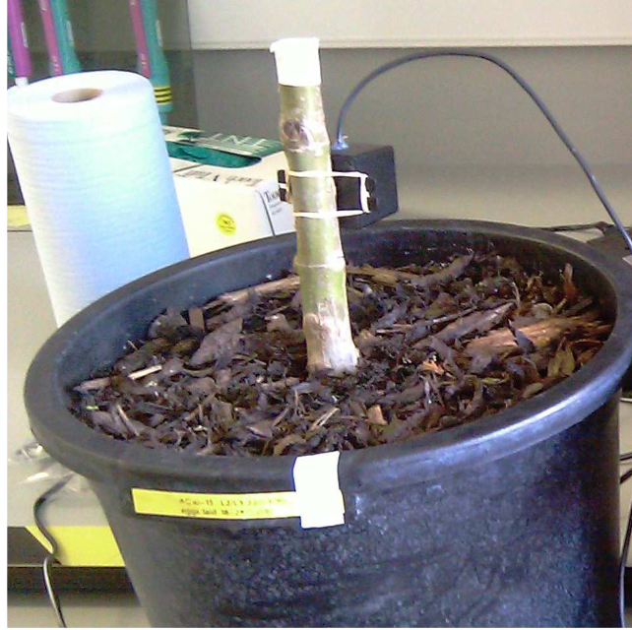

Slide 31
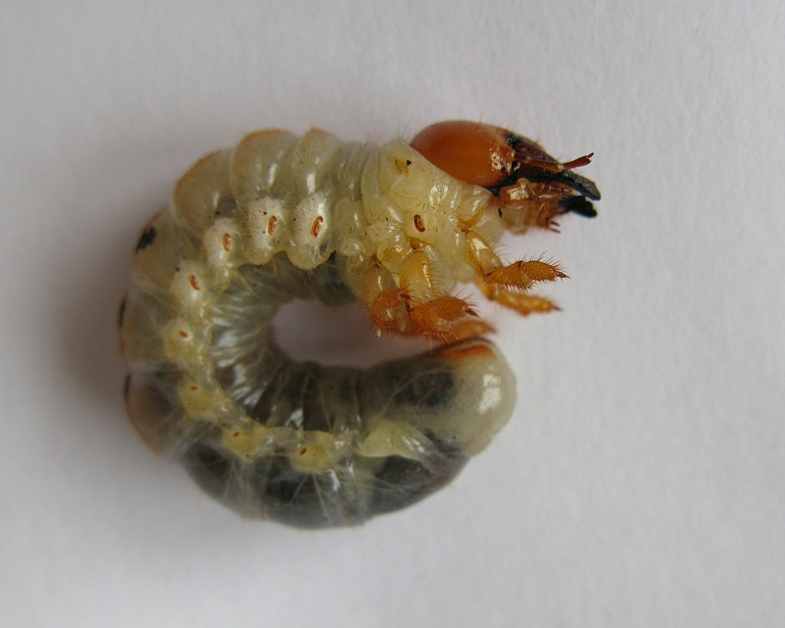

Slide 32
Incidental Noises

Slide 33
Some Other (non-obvious) sounds

Slide 36
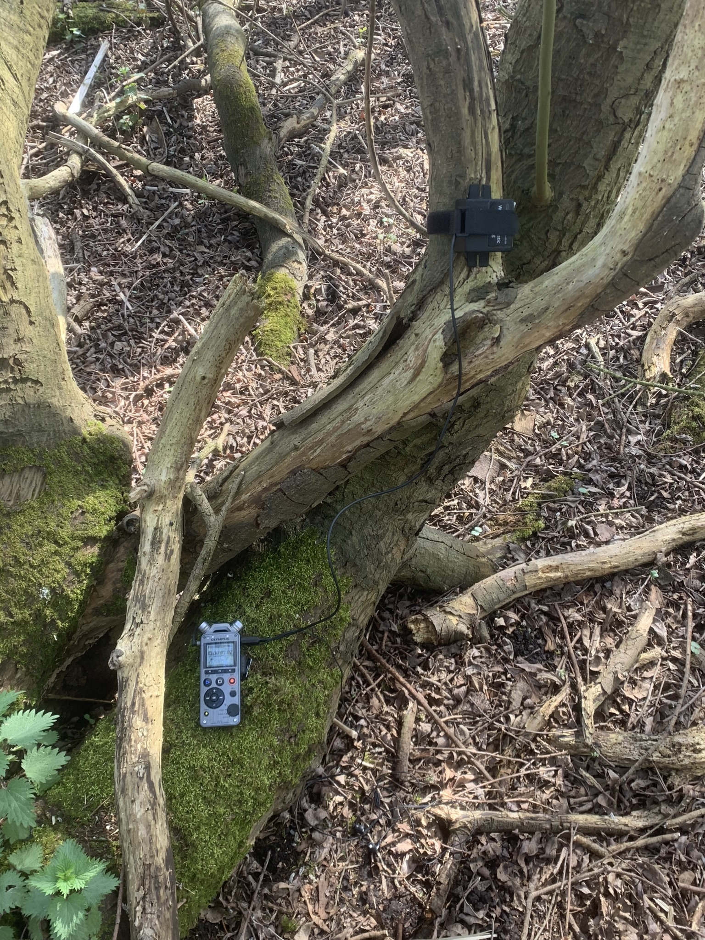

Slide 39
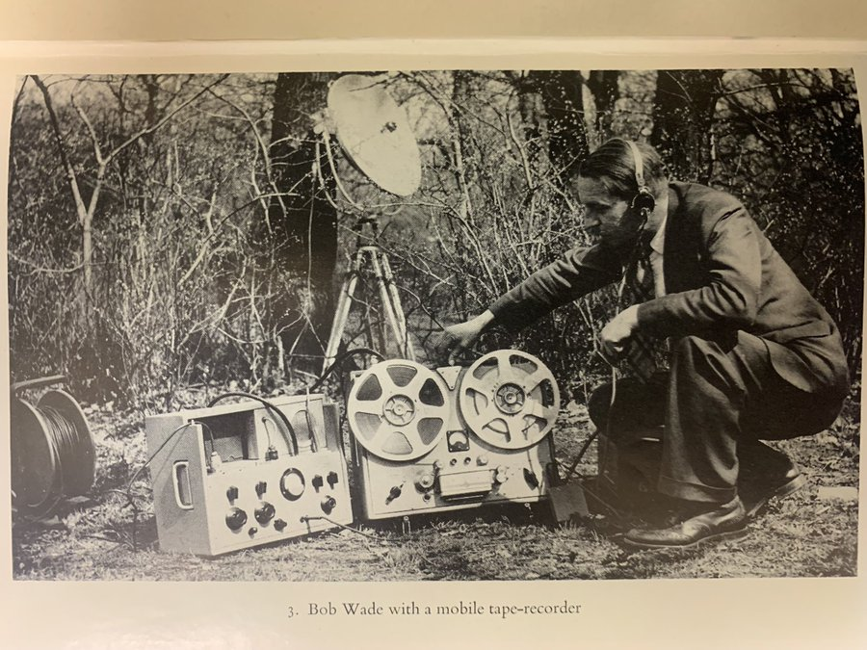

Slide 41
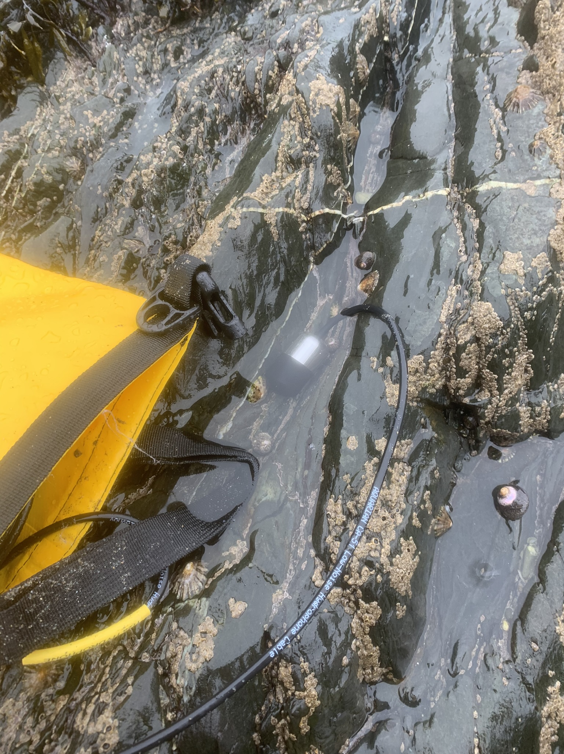

Slide 42
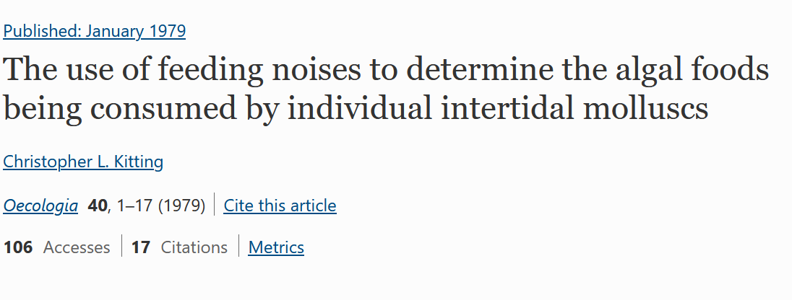

Slide 43
Brief overview of automated ID

Slide 44
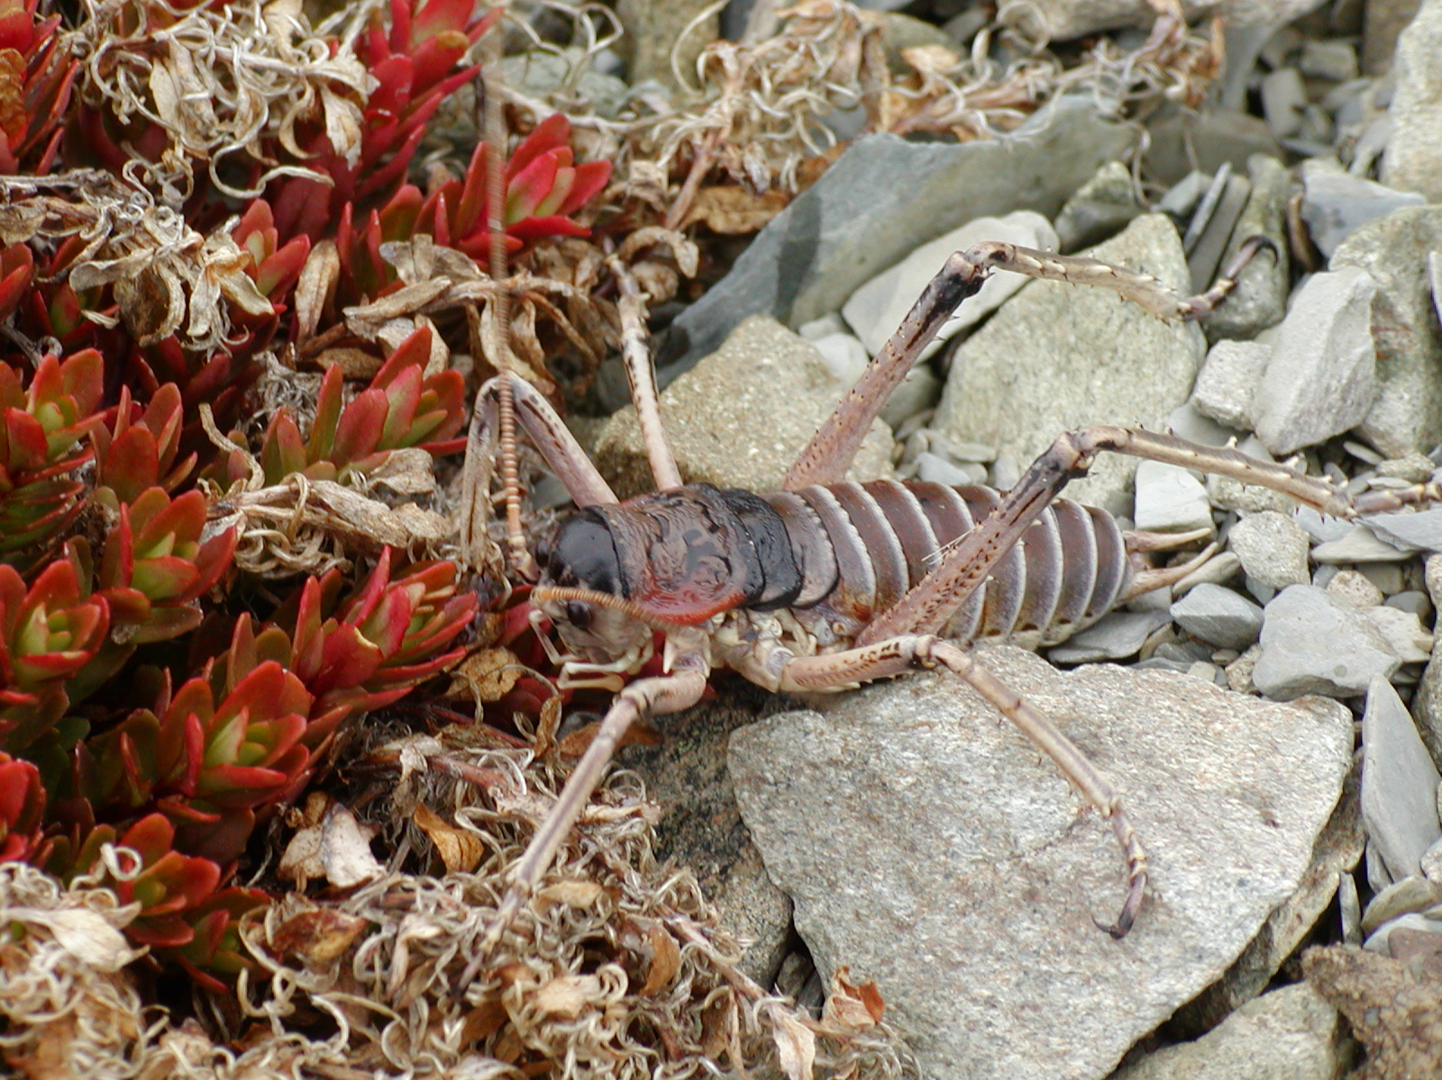
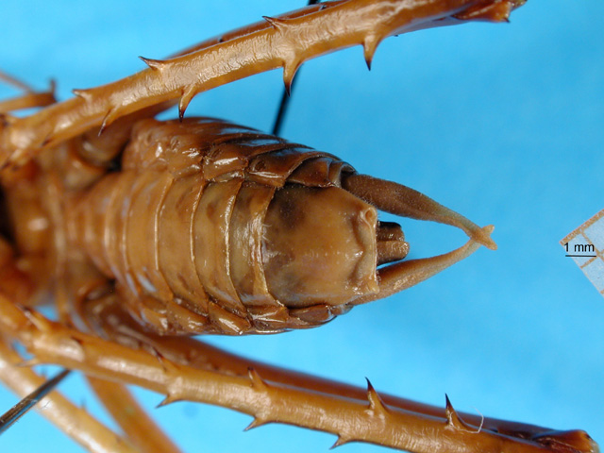

Slide 45
Organism
Characters
Identification

Slide 46
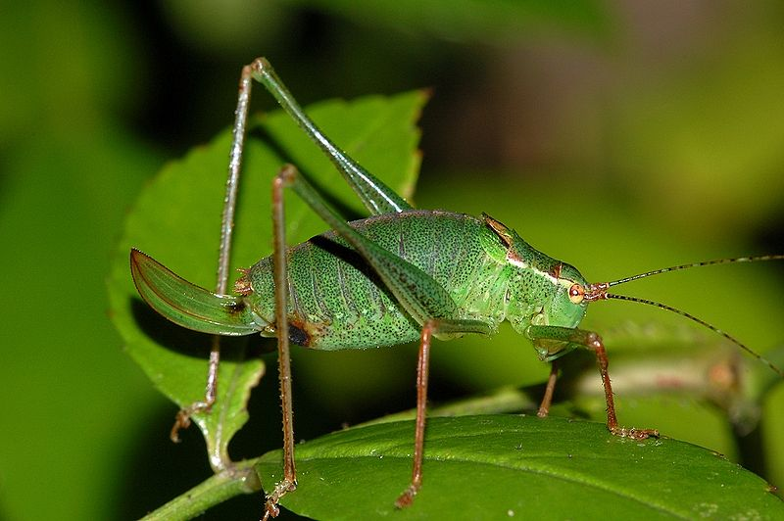
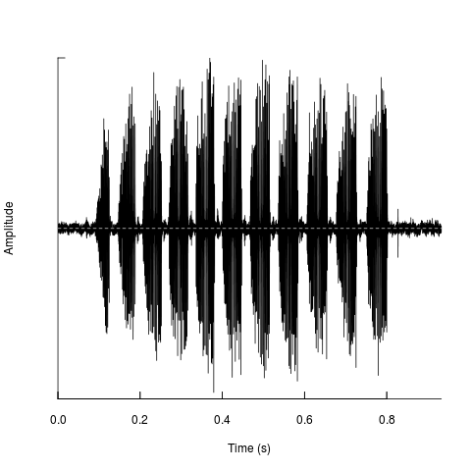
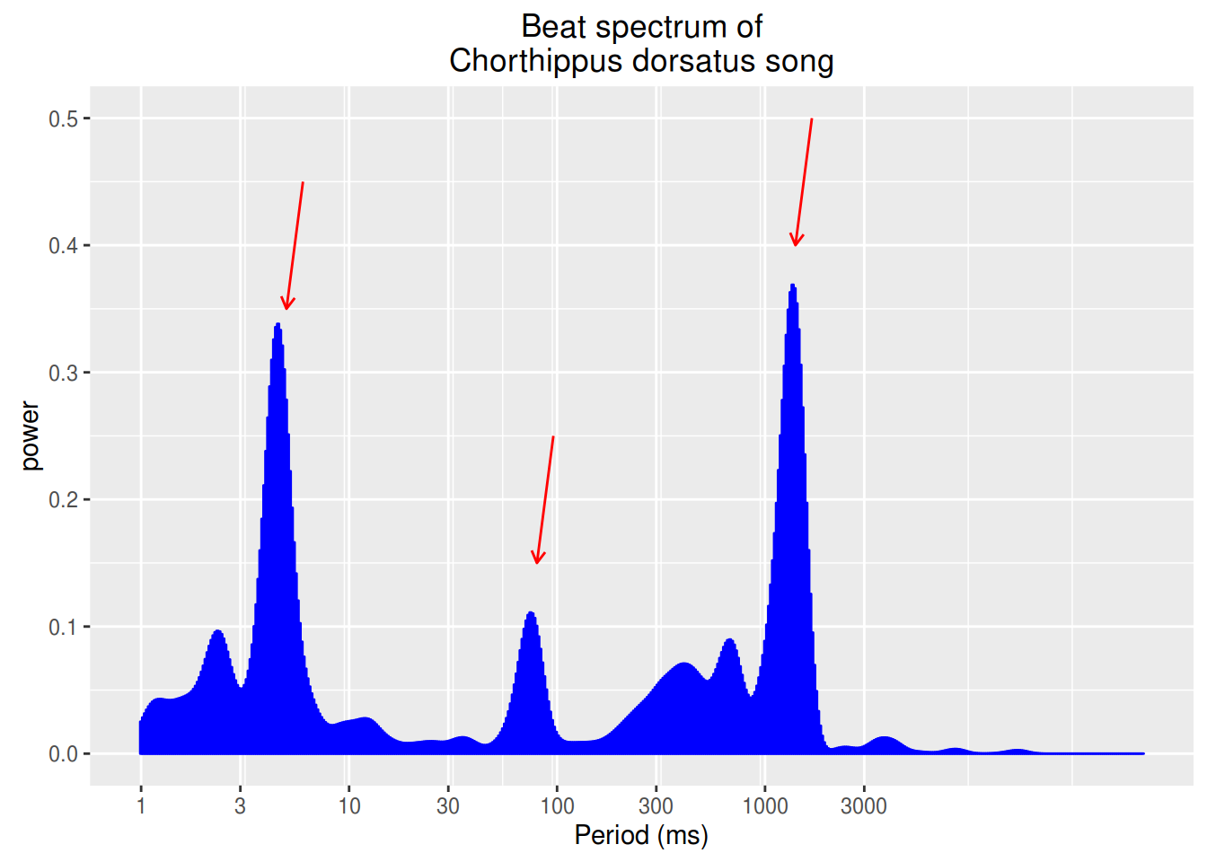
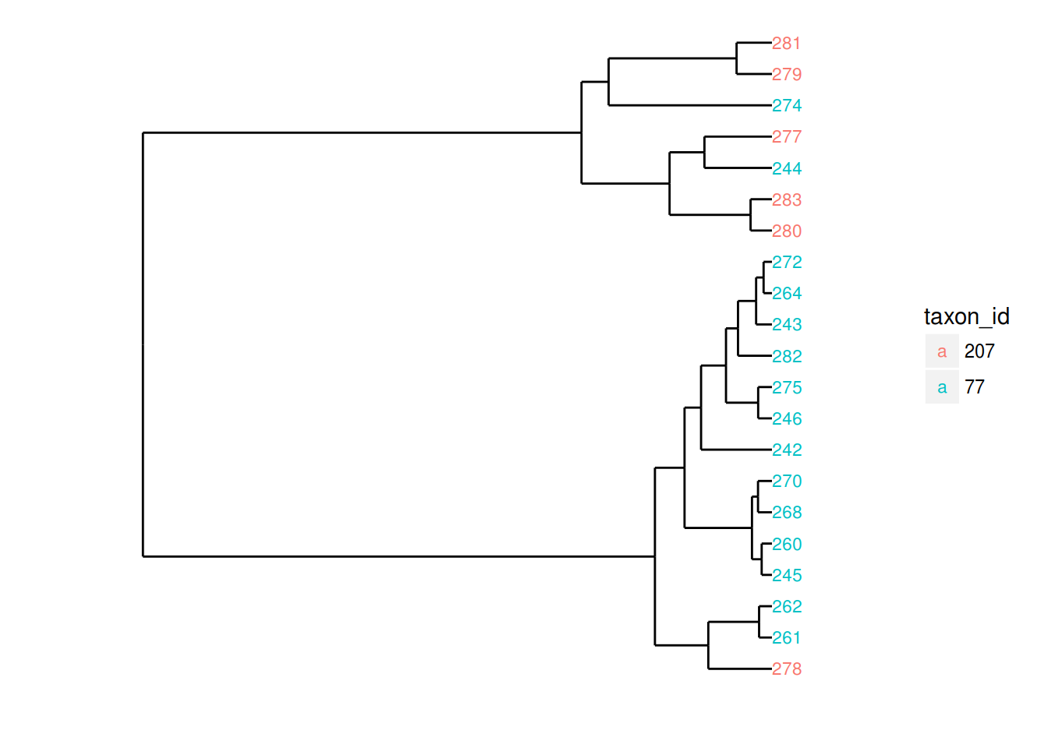
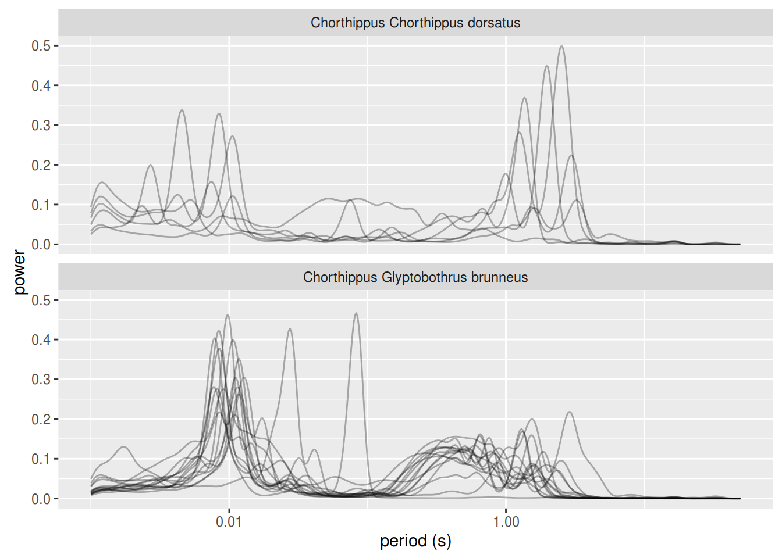

Slide 47
Organism
Feature Extraction
Classification

Slide 48
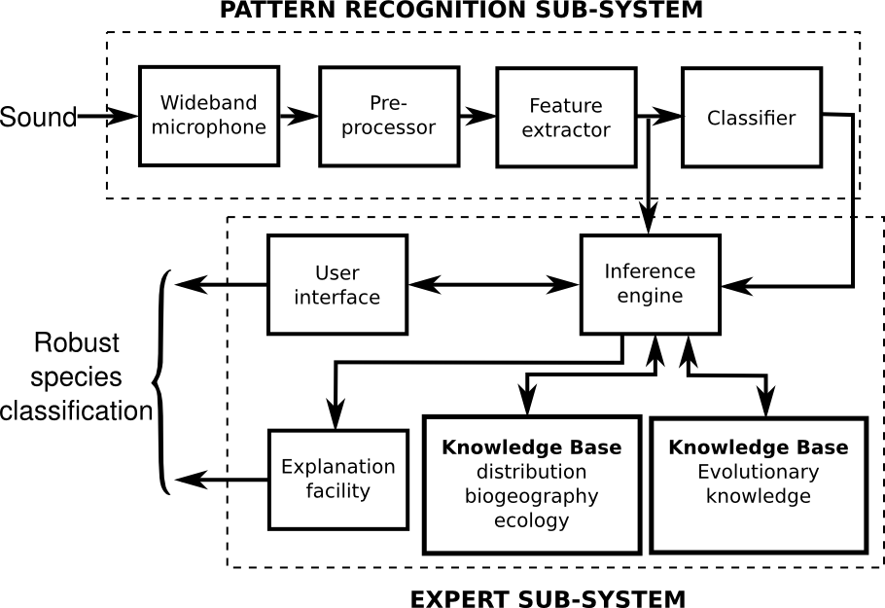

Slide 49
The Pieces

Slide 50
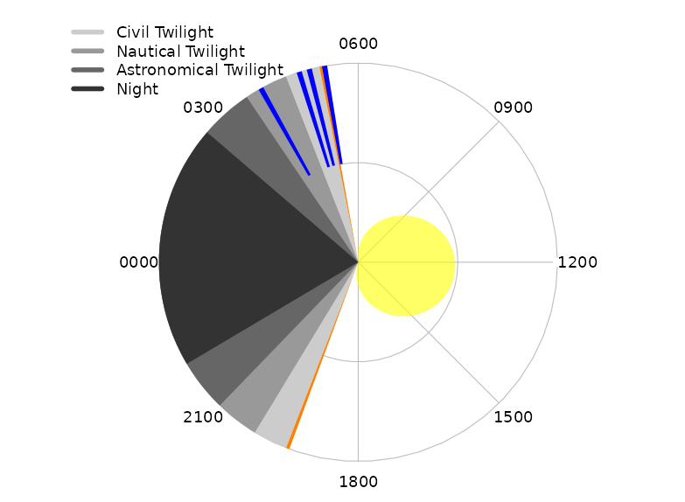

Slide 51
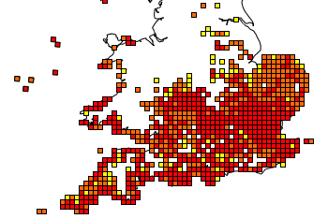
Leptophyes punctatissima
1980-1990
1990-2000
2000-2010

Slide 52
Leptophyes punctatissima
1980-1990
1990-2000
2000-2010

Slide 53
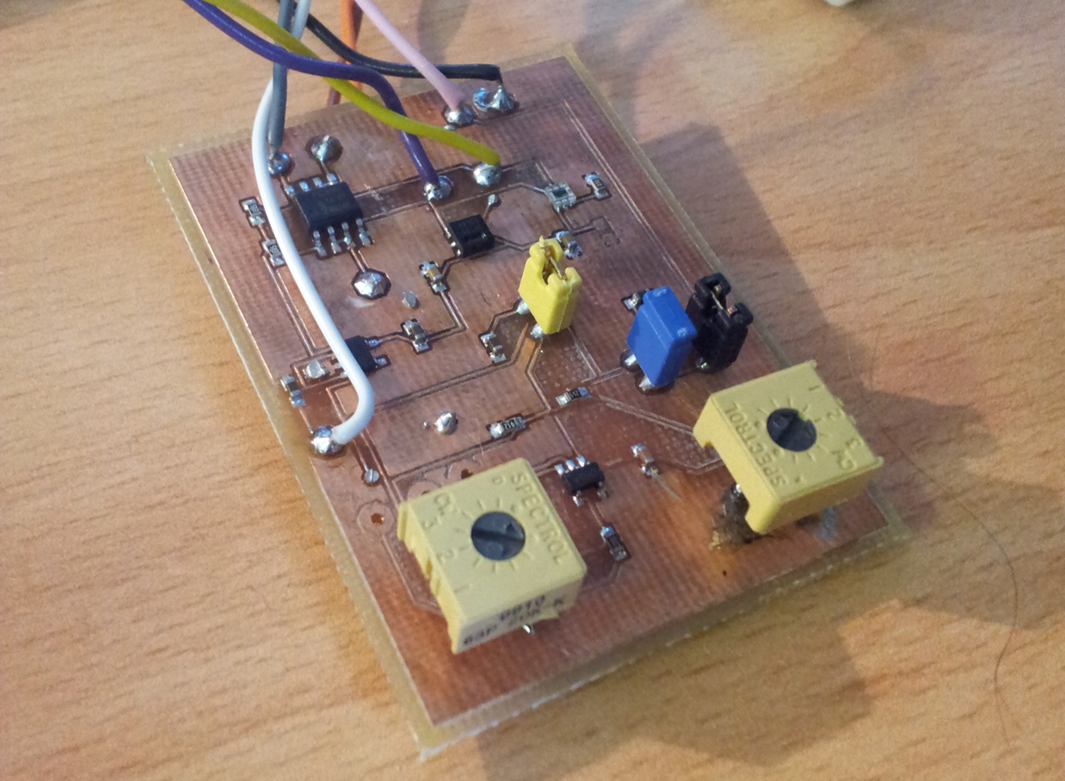
Leptophyes punctatissima

Slide 54
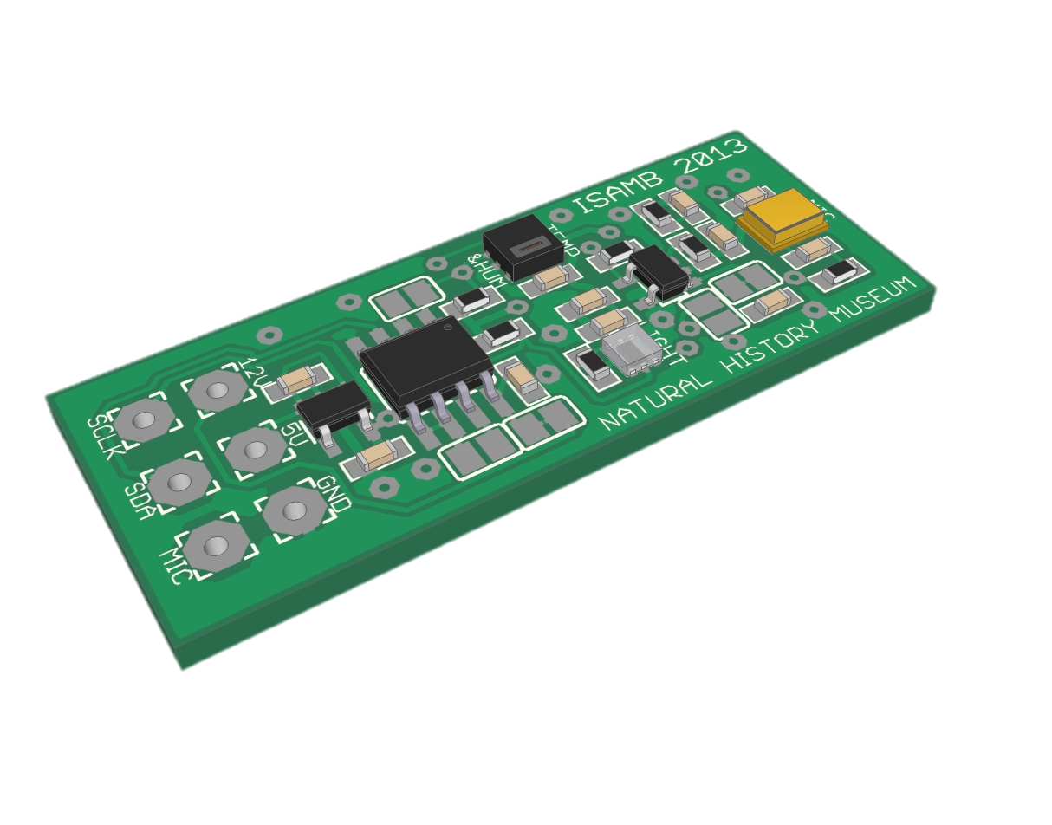
Leptophyes punctatissima

Slide 55
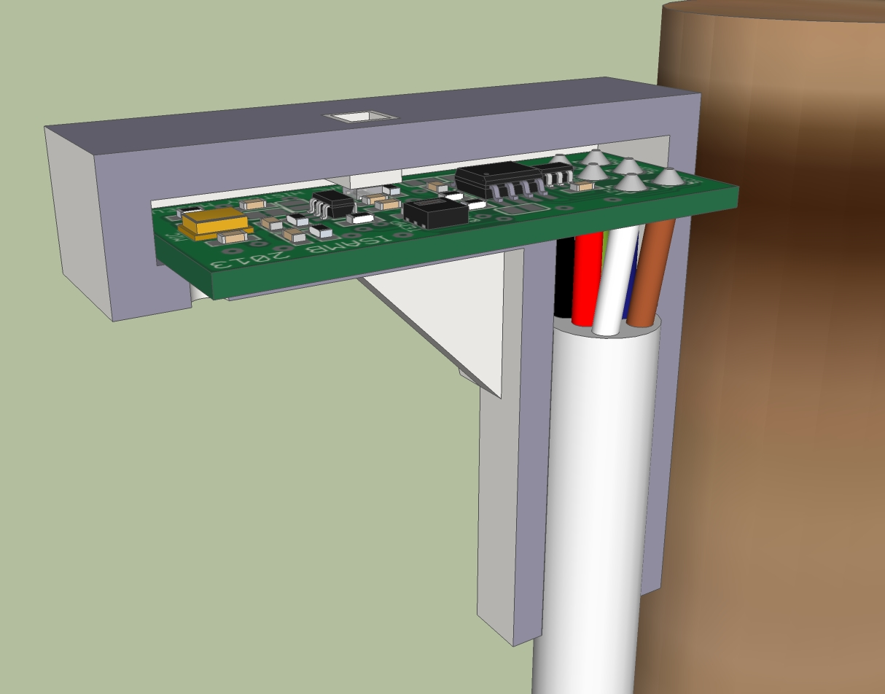
Leptophyes punctatissima

Slide 56
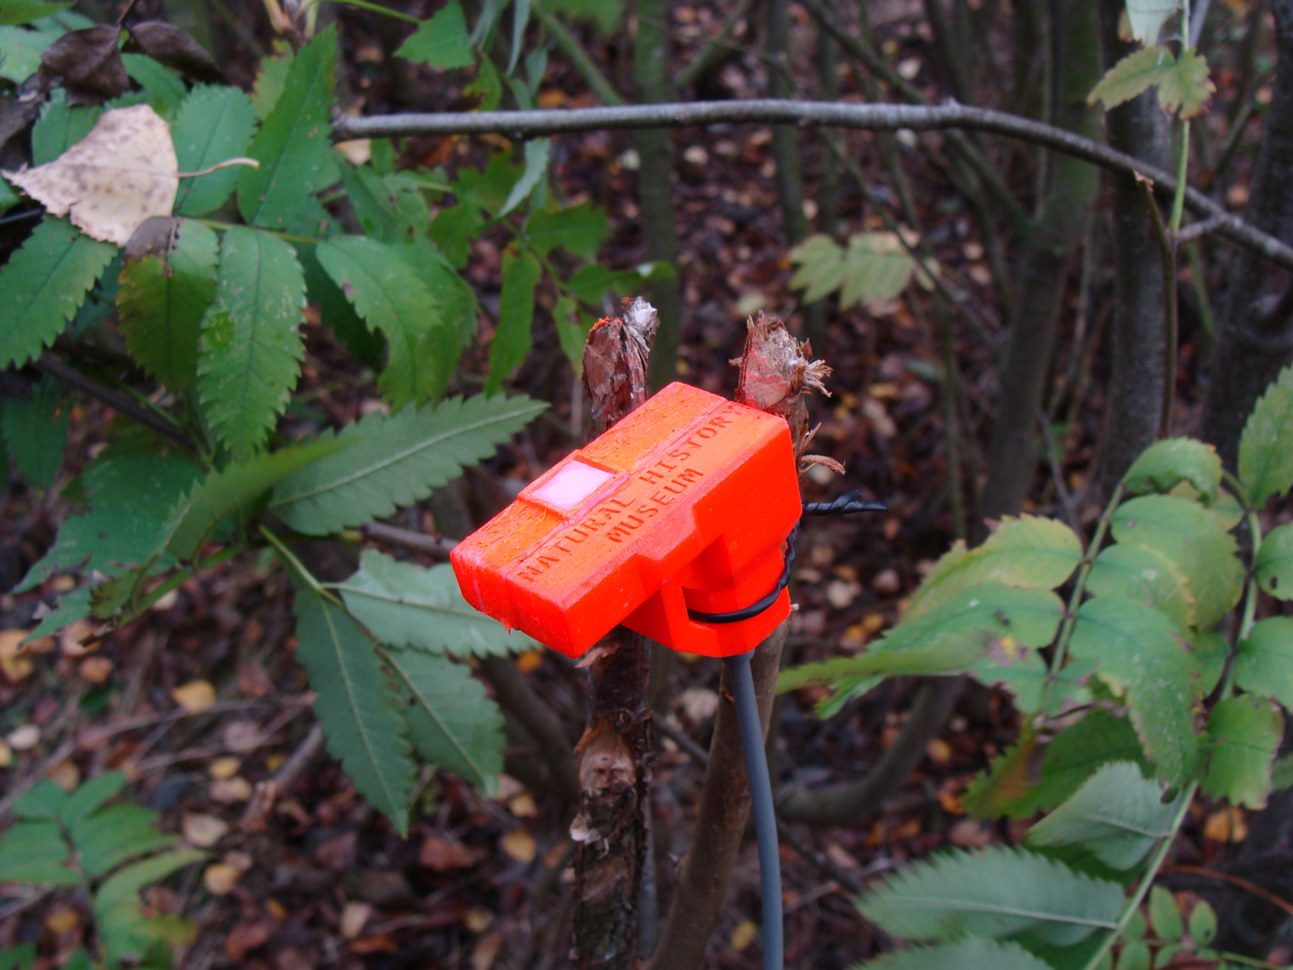
Leptophyes punctatissima

Slide 57
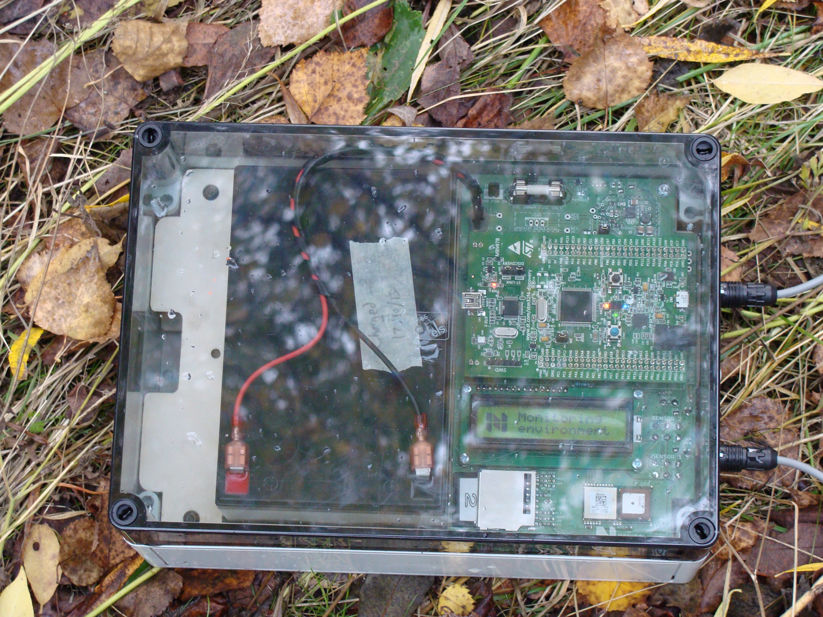
Leptophyes punctatissima

Slide 58
Previous ACOUSTICS WORK AT NHM

Slide 59
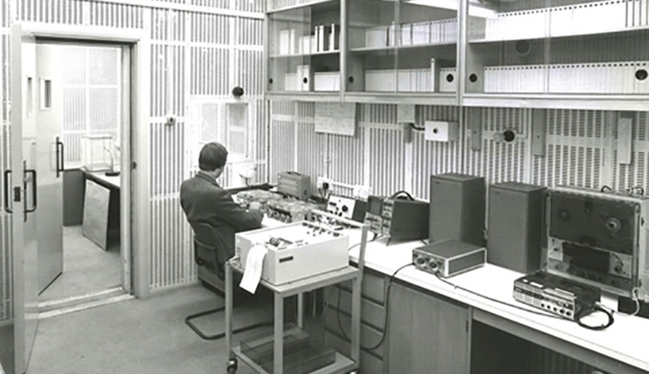
Previous ACOUSTICS WORK AT NHM

Slide 60
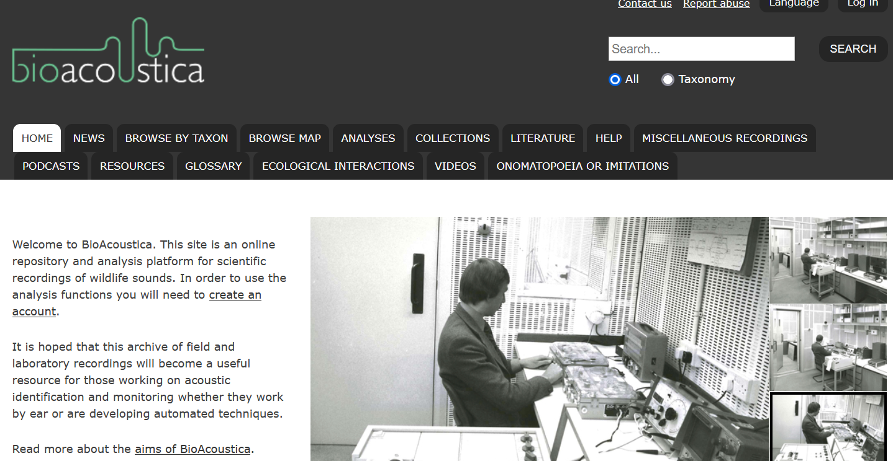

Slide 62
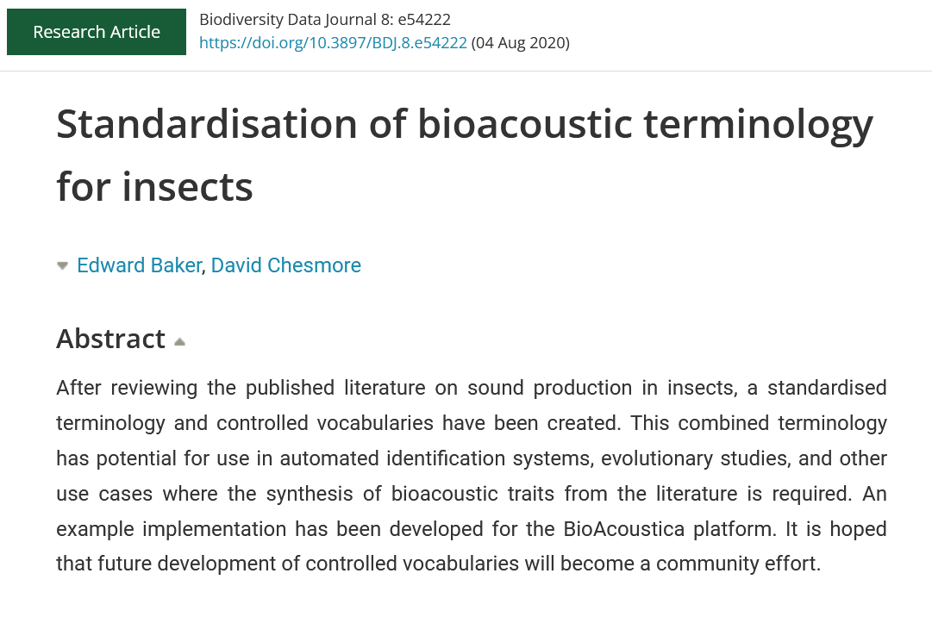

Slide 63
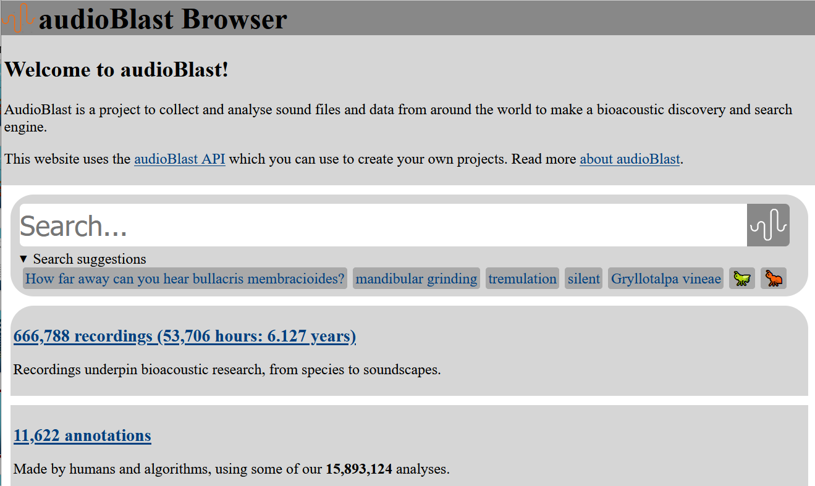

Slide 64
NEW NHM Approach: From The Lab to The Field
BIOACOUSTICS
ECOACOUSTICS
Single species
Ecosystems
Single microphones
Microphone arrays
Sensor networks
Species descriptions
Behavioural studies
Sound collections
(https://bio.acoustic.ca)
Statistical analyses
Machine Learning

Slide 65
NEW NHM Approach: From The Lab to The Field
BIOACOUSTICS
Complexity, Cost
ECOACOUSTICS
Single species
Ecosystems
Single microphones
Microphone arrays
Sensor networks
Species descriptions
Behavioural studies
Sound collections
(https://bio.acoustic.ca)
Statistical analyses
Machine Learning

Slide 66
NEW NHM Approach: From The Lab to The Field
BIOACOUSTICS
Complexity, Cost
ECOACOUSTICS
Single species
Ecosystems
Single microphones
Microphone arrays
Sensor networks
Species descriptions
Behavioural studies
Sound collections
(https://bio.acoustic.ca)
Aggregated data sources
Statistical analyses
Machine Learning
One computer
Many computers

Slide 67
NEW NHM Approach: From The Lab to The Field
BIOACOUSTICS
Complexity, Cost
ECOACOUSTICS
Single species
Ecosystems
Single microphones
Microphone arrays
Sensor networks
Species descriptions
Behavioural studies
Sound collections
(https://bio.acoustic.ca)
Aggregated data sources
Statistical analyses
Machine Learning
One computer
Many computers

Slide 68
Urban Nature Project
Changing the scope, scale and speed of acoustic monitoring
Bringing technology to environmental challenges
Integrating bioacoustics with other methods

Slide 70
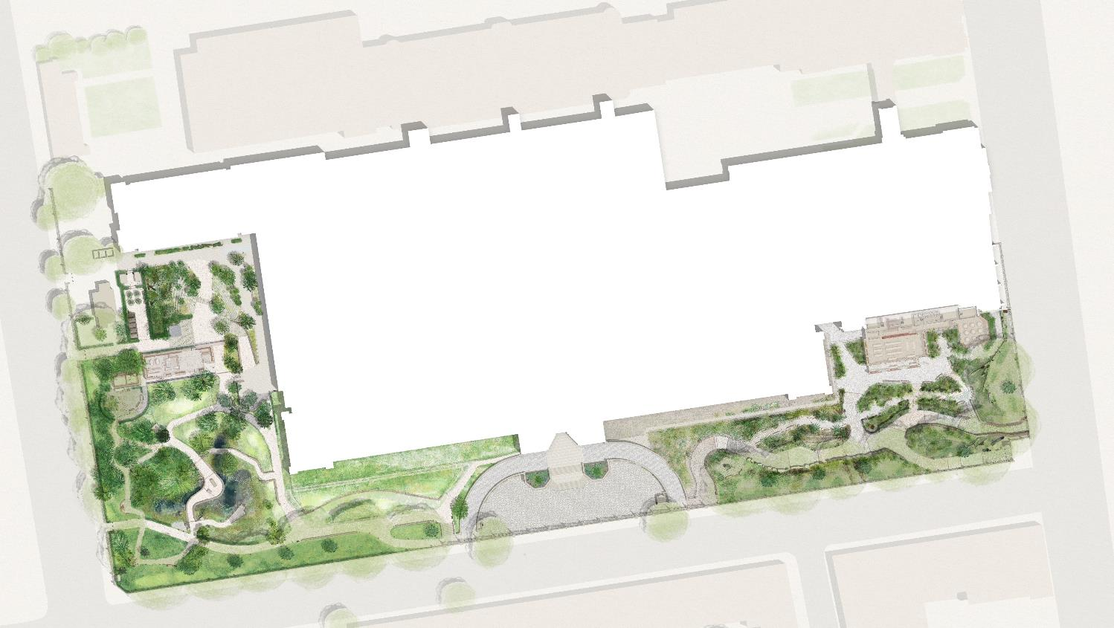
We currently monitor ‘our’ biodiversity using visual and eDNA methods
2024 onwards will also include bioacoustic and environmental parameters across a 25+ point IoT sensor array
Long-term monitoring plus detailed case studies of how habitat translocation, creation and restoration actions impact biodiversity
Data infrastructure to capture, share and support co-analysis and visualisation of these multiple data types

Slide 71
A bit on NOISE
It is estimated that the annual social cost of urban road noise in England is £7 billion to £10 billion.
Most studies focus on mammals
What about non-airborne sounds?
Can we find mitigations that also support biodiversity recovery?
https://www.gov.uk/guidance/noise-pollution-economic-analysis

Slide 72
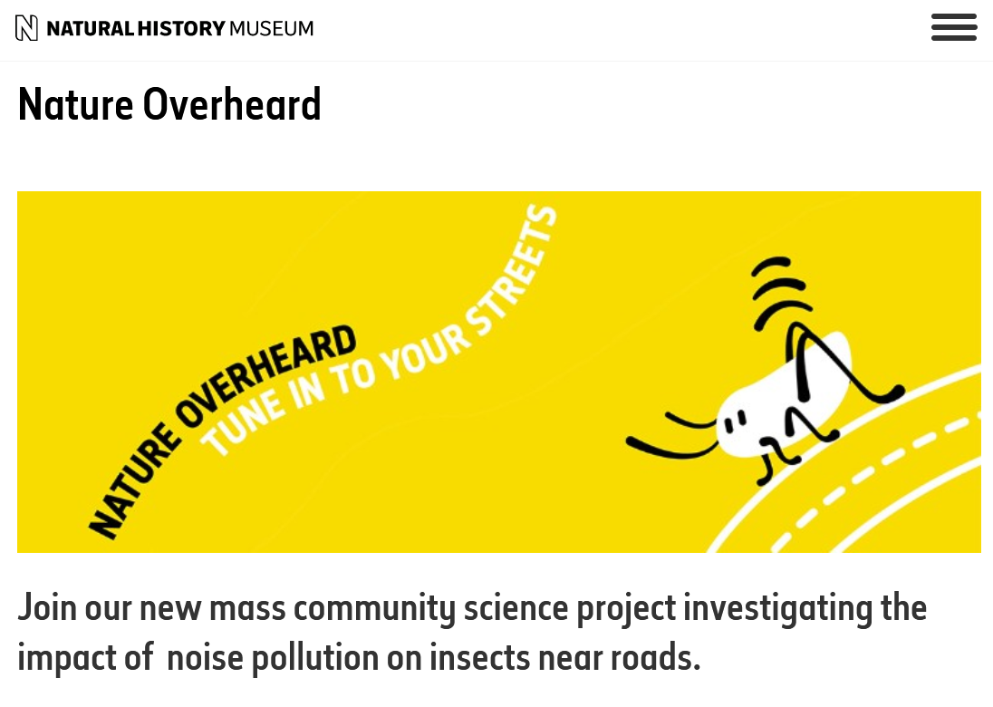

Slide 73
Q&a NHM Acoustics Research: 🦗.fm (xn--nt9h.fm) Sound Collection: bio.acousti.ca / audioblast.org Search for Nature Overheard ebaker.me.uk

